Slide 1

Dashboard Automation
-SHAURYA KHURANA

Slide 2
Content
Test Cases for Verification of Dashboard
Report Verification
Update Values for Upgrades
Verification of subsequent Upgrades

Slide 3
Test Cases
Verify Resiliency Group counts
Verify Risks Counts
Display VMware Counts
Verify Replication Graph
Verify Recovery time Graph
Verify Activity Summary

Slide 4
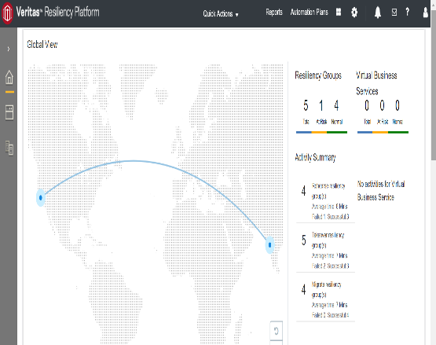
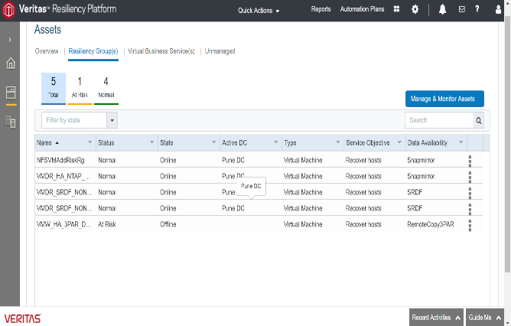
Verify Resiliency Group counts

Slide 5
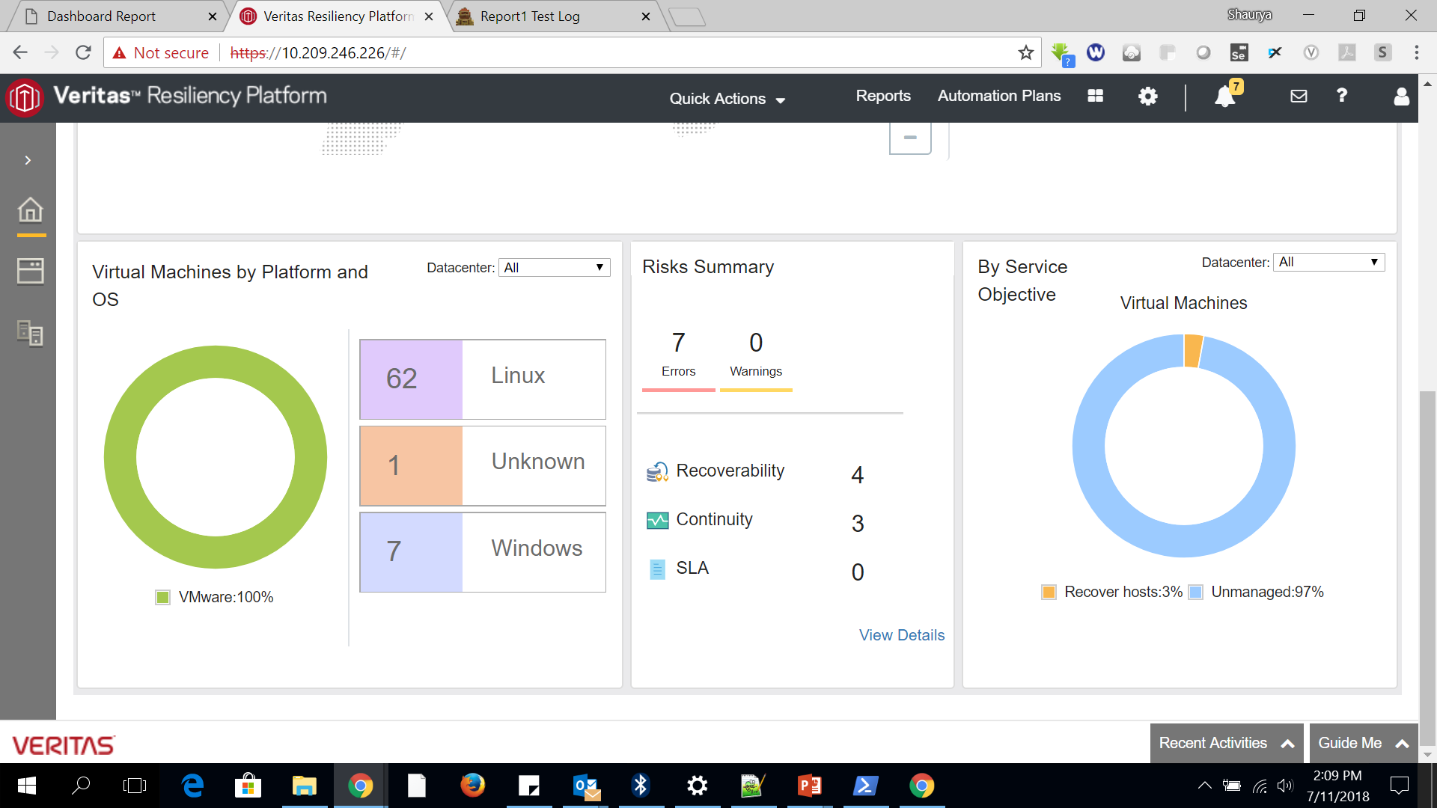
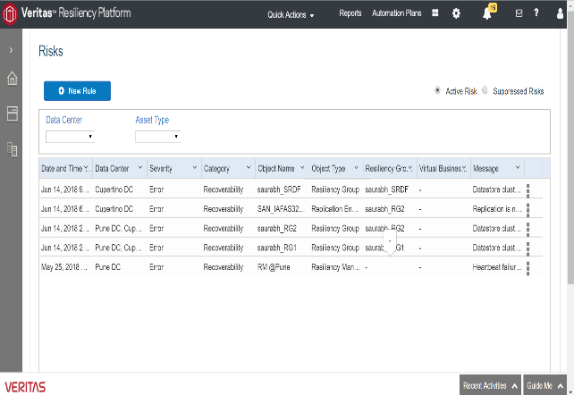
Verify Risks Counts

Slide 6
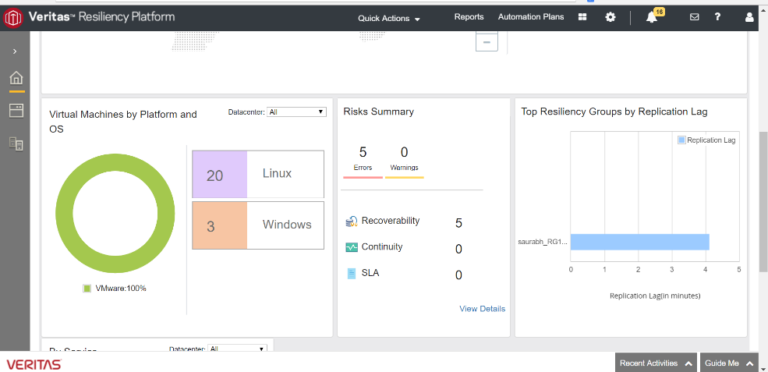
Display VMware Counts

Slide 7
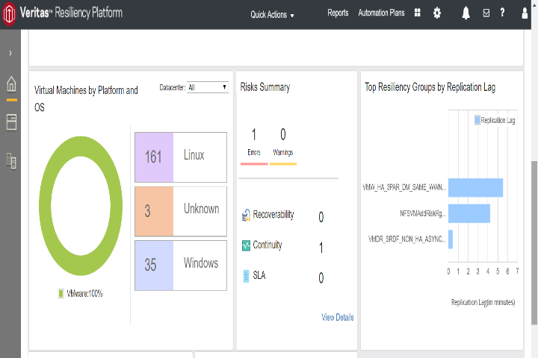
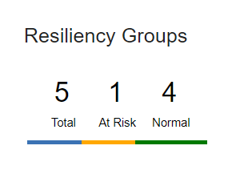
Verify Replication Graph

Slide 8
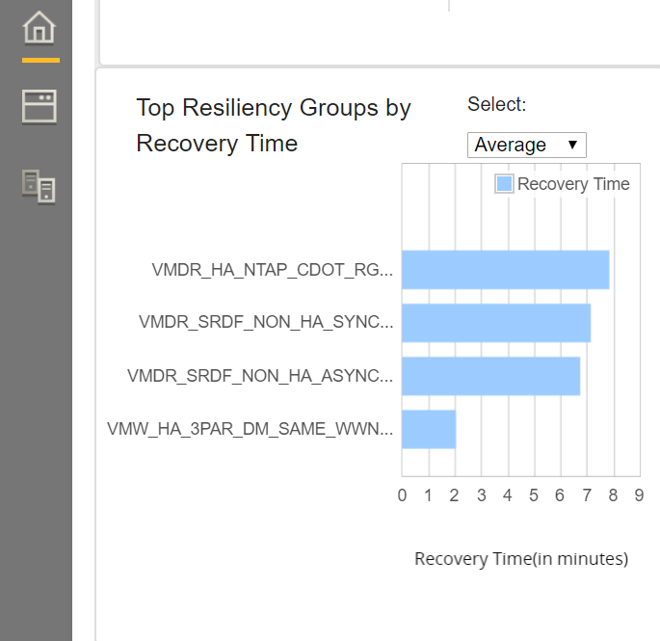
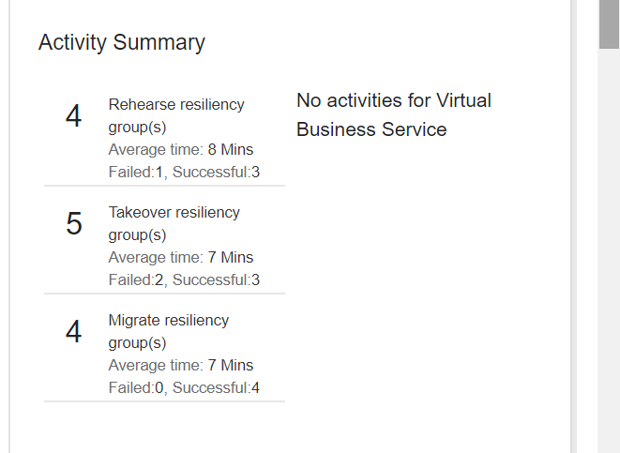
Verify Recovery time Graph

Slide 9
Verify Activity Summary
1. Verify Rehearse RG Activities
2. Verify Takeover RG Activities
3. Verify Migrate RG Activities

Slide 10
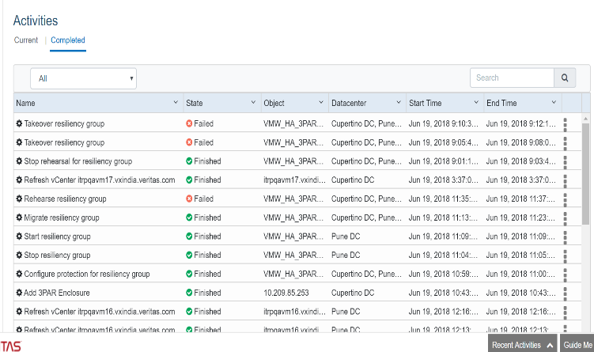
Verify Activity Summary

Slide 11
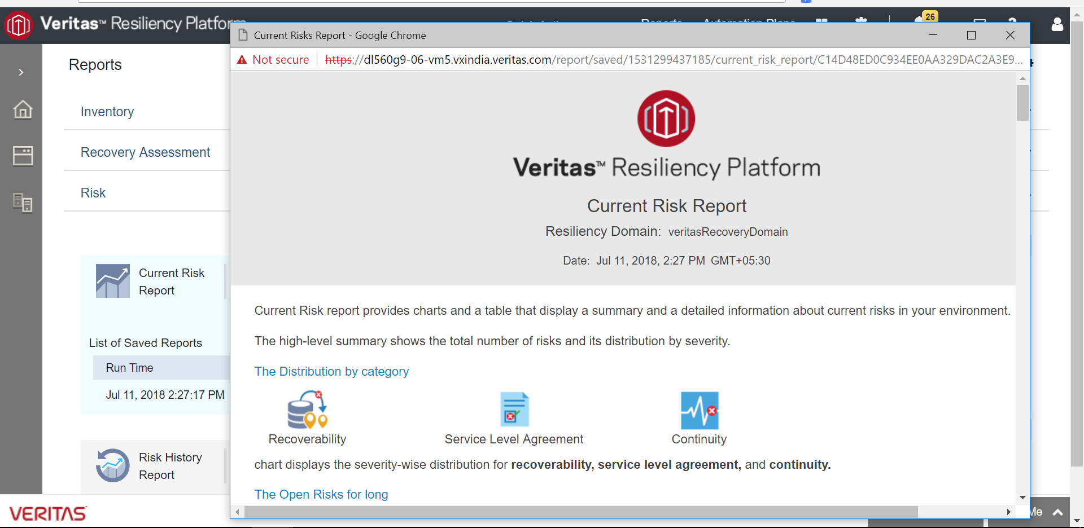
Report Automation

Slide 12
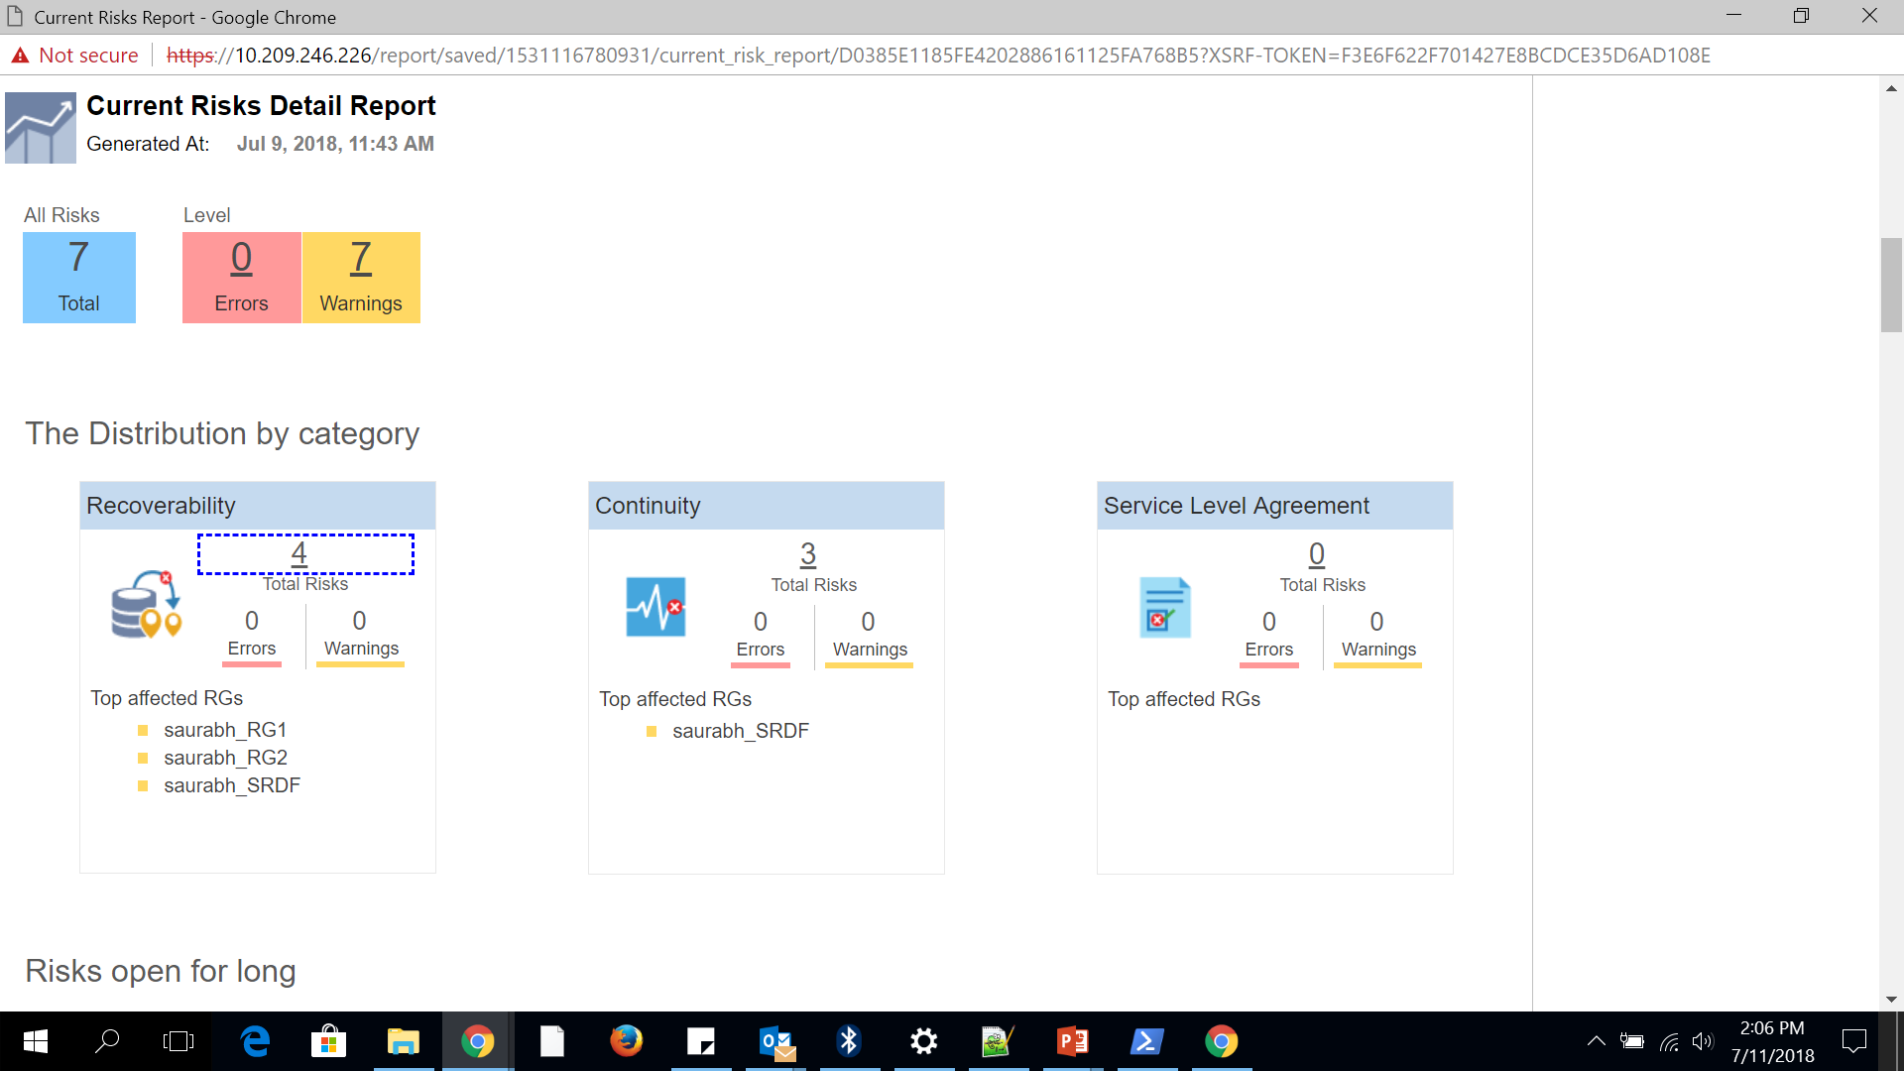
Report Verification

Slide 13
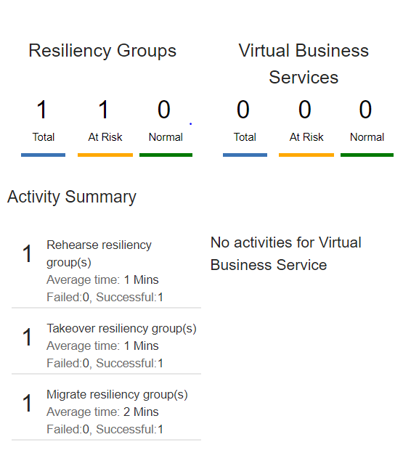
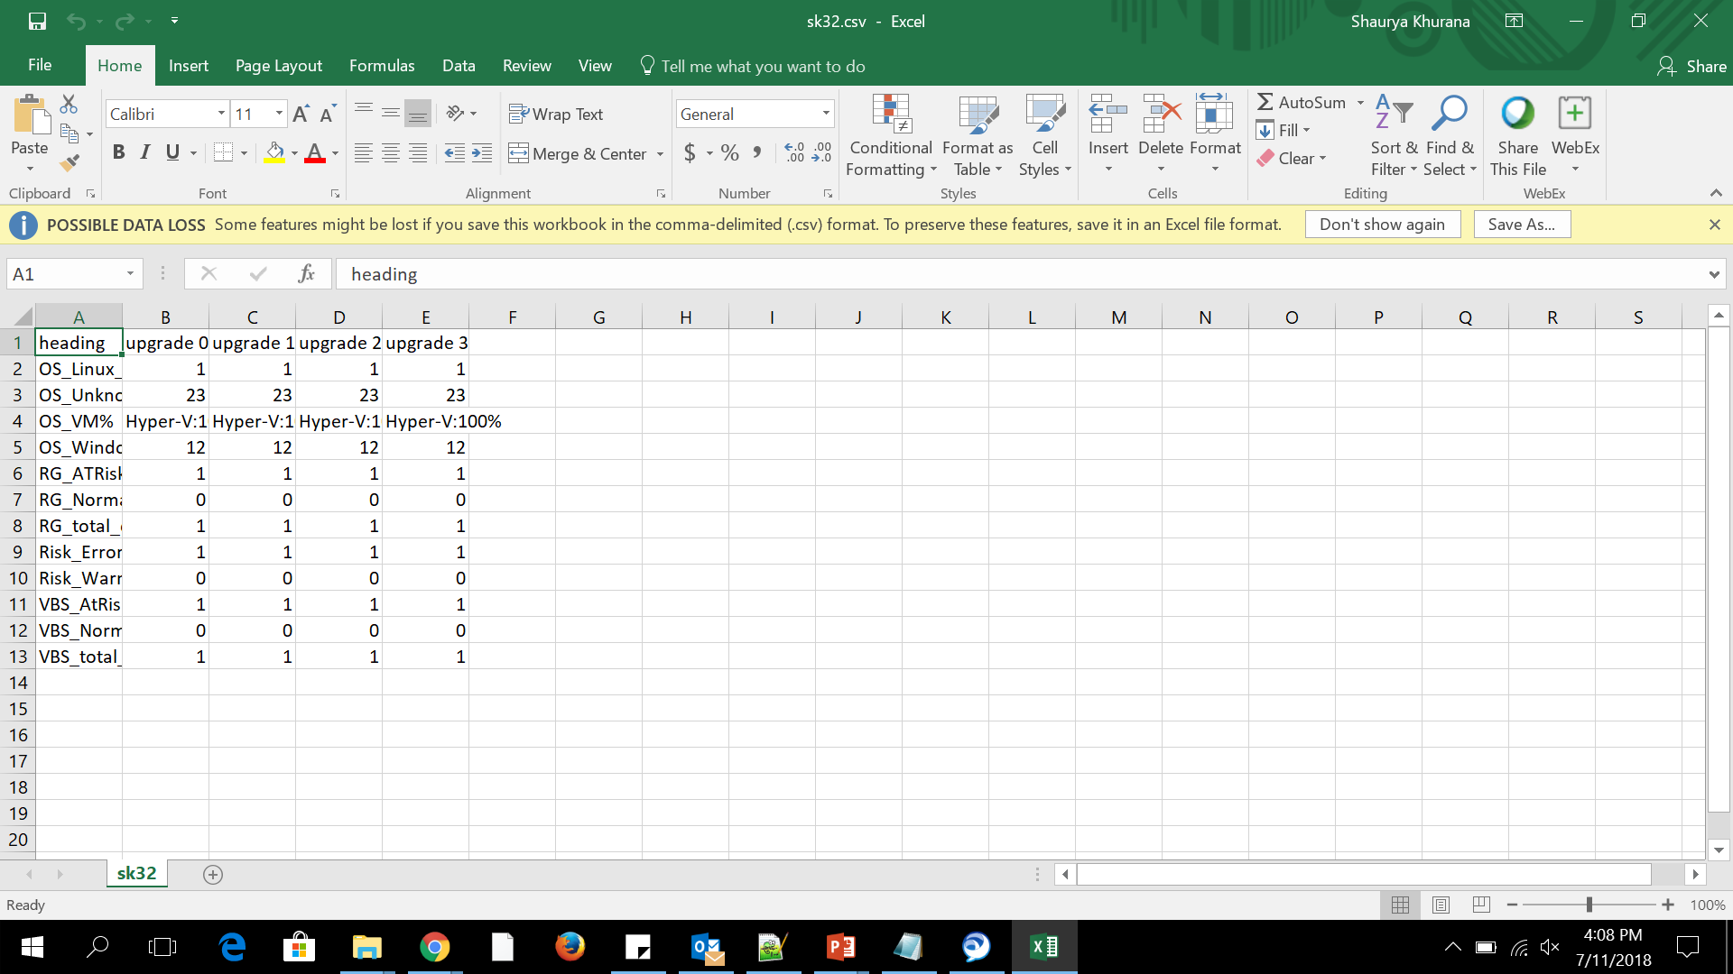
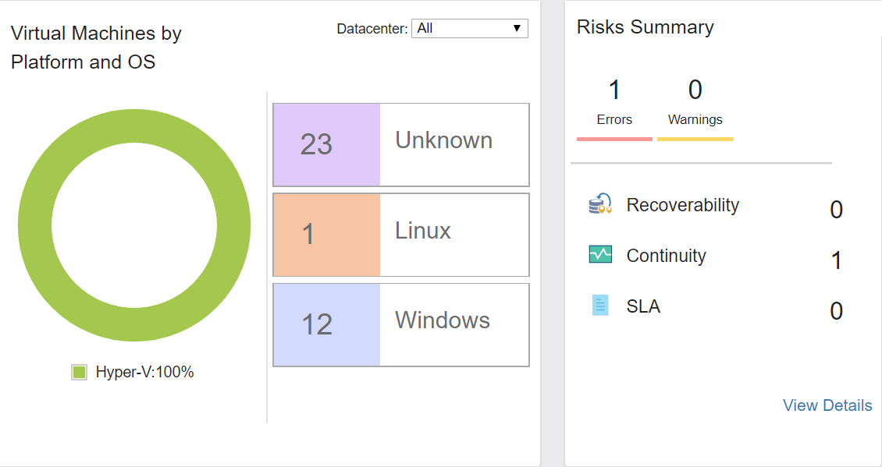
Upgrade update and verification

Slide 14
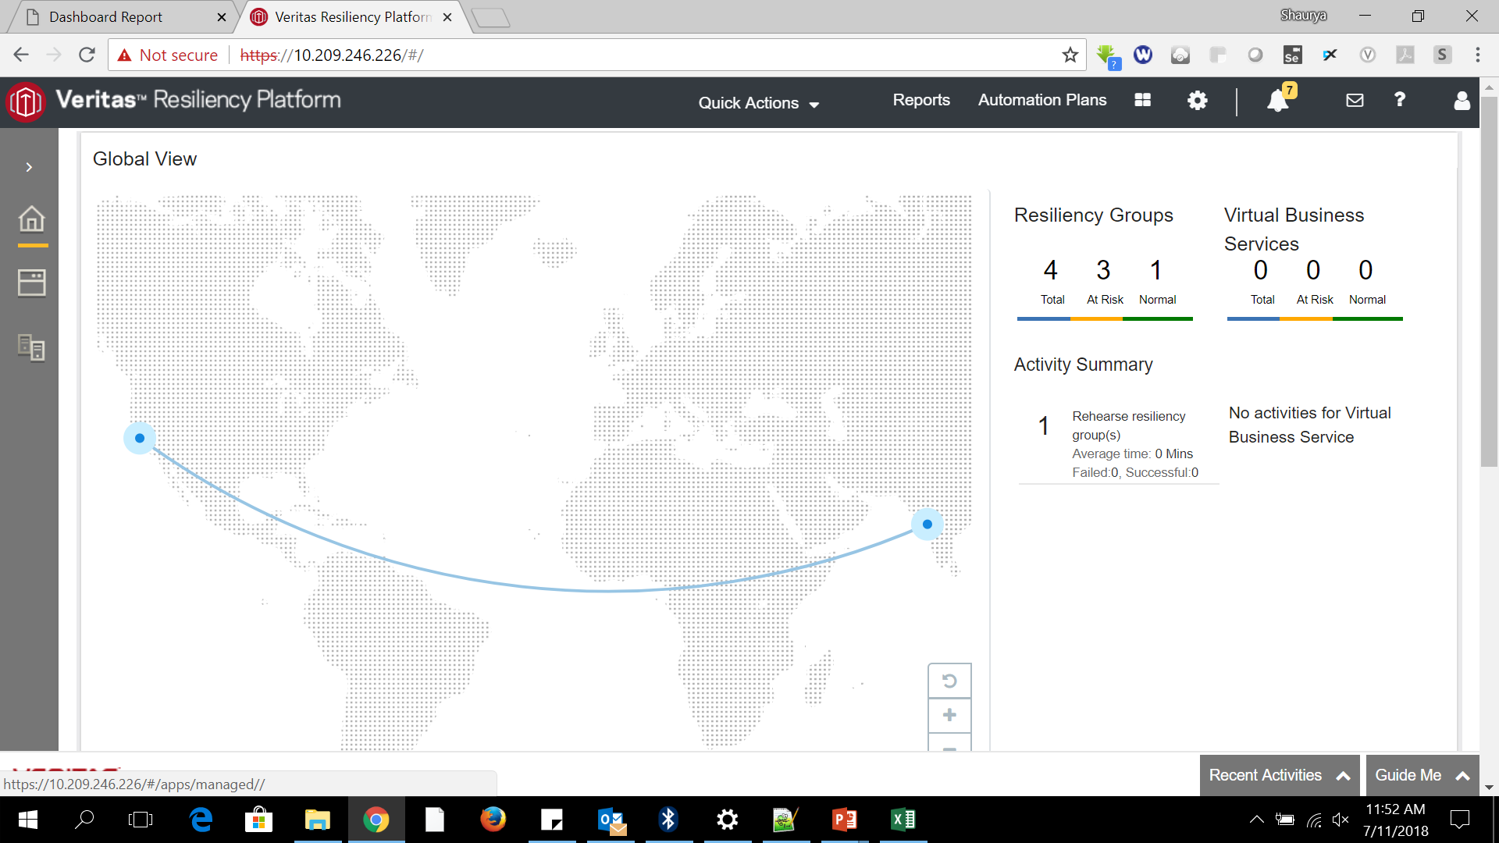
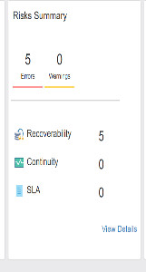
Update Values for Upgrades

Slide 15
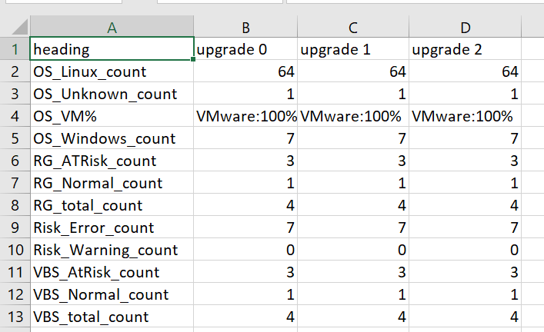
Update Values for Upgrades

Slide 16
Verification for subsequent Upgrades

Slide 17
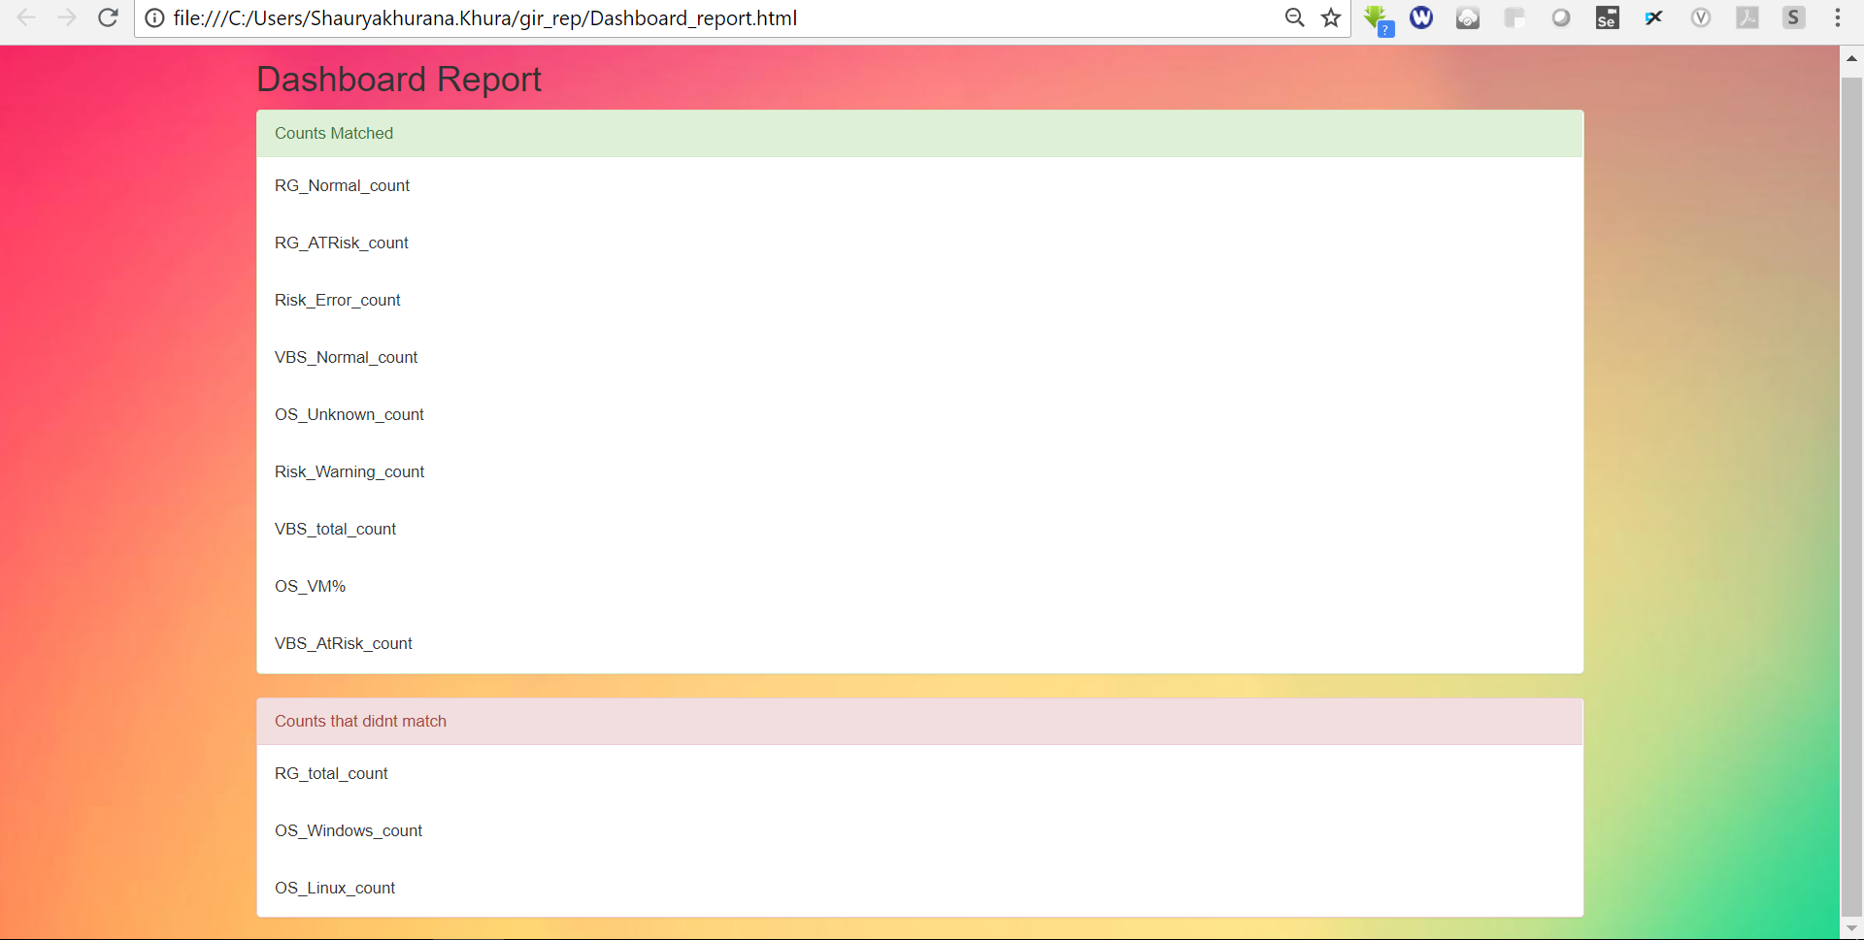
Verification for subsequent Upgrades

Slide 18
Analysis and Merits
Attractive report
Time taken is very less
Upgrade verification (< 5sec)
Report Verification (<10sec)
Generic locators
Handles all the Exceptions
Dynamic creation of excel and report files

Slide 20
Shaurya Khurana
Shauryakhurana.Khura@veritas.com
8007810259

